Slide 1
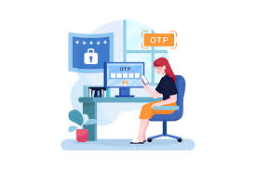
OTP VERIFICATION SYSTEM

Slide 2
CONTENTS
Objective
Problem Statement
What is One Time Password(OTP)
Benefits of OTP
Code
Code explanation and design steps
Output of verification using OTP
Conclusion

Slide 3
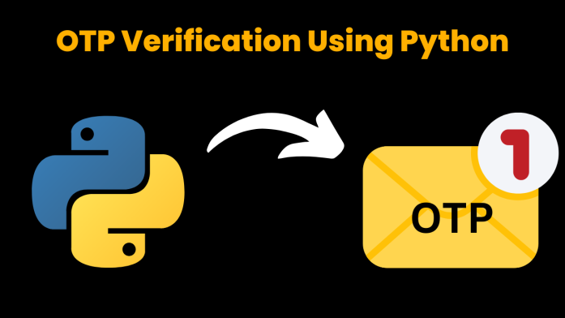
OBJECTIVE : To build an “OTP Verification System” with python
Purpose:
A one-time password (OTP) is an automatically generated numeric or alphanumeric string of characters that authenticates a user for a single transaction or login session.
IDE : Jupyter Notebook
Importing necessary libraries, modules:
Random : Import ’random’ modules to generate random numbers for the OTP.
SMTP (smtplib) : Simple Mail Transfer Protocol (SMTP) is a protocol, which handles sending e-mail and routing e-mail between mail servers.
tkinter : Import tkinter as tk for creating the Graphical User Interface(GUI) for this project.

Slide 4
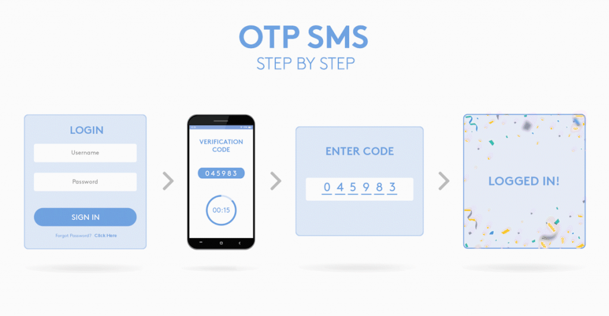
PROBLEM STATEMENT
The system should generate a 6-digit OTP and send it to the user's email address for verification. Upon receiving the OTP, the user should enter it into the system for validation. If the entered OTP matches the generated OTP, access should be granted; otherwise, access should be denied.

Slide 5
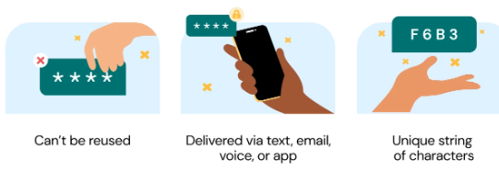
ONE TIME PASSWORD(OTP)
A one-time password (OTP), also known as a one-time PIN, one-time authorization code (OTAC) or dynamic password, is a password that is valid for only one login session or transaction, on a computer system or other digital device.
Key features of one-time passwords(OTPs) are -

Slide 6
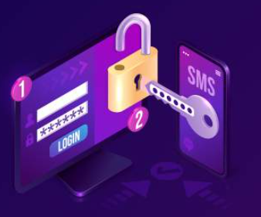
BENEFITS OF OTP
Enhanced security - OTP adds an extra layer of security to traditional passwords and password-based authentication.
Convenient to use - The majority of people own a mobile phone, and SMS functionality is available on all devices. Because SMS is so common, one-time passwords are simple to use.
Protection Against Phishing Attacks - OTP verification provides an effective defense against phishing attacks, as even if users unknowingly provide their login details, the one-time code required for verification remains secure on their mobile device or email.

Slide 7
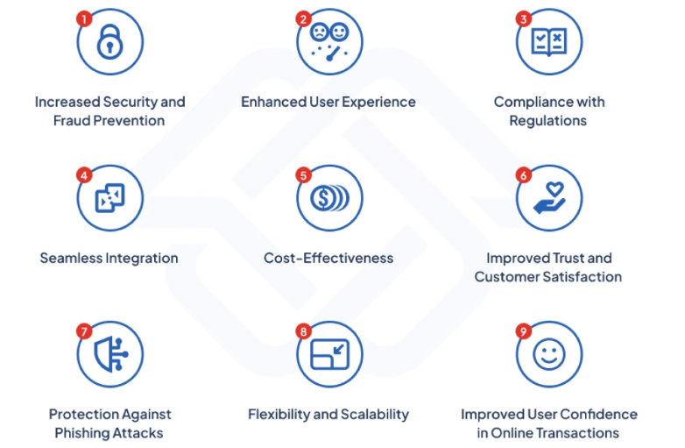
BENEFITS OF OTP

Slide 8
CODE EXPLANATION AND DESIGN STEPS
Step 1: Open Jupyter Notebook in the Anaconda prompt and start writing the code in its cell.
Step 2: In code, from tkinter import * represents all the functions and built-in modules in the tkinter library.
Step 3: Import random modules to generate random numbers for the OTP.
Step 4: Import smtplib Simple Mail Transfer Protocol (SMTP) is a protocol, which handles sending e-mail and routing e-mail between mail servers.
Step 5: Import tkinter as tk Import tkinter as tk for creating the Graphical User Interface(GUI) for this project.
Step 6: from tkinter import messagebox Tkinter Messagebox is a module which provides a different set of dialogues that are used to display message boxes, showing errors or warnings, widgets to select files or change colors.

Slide 9
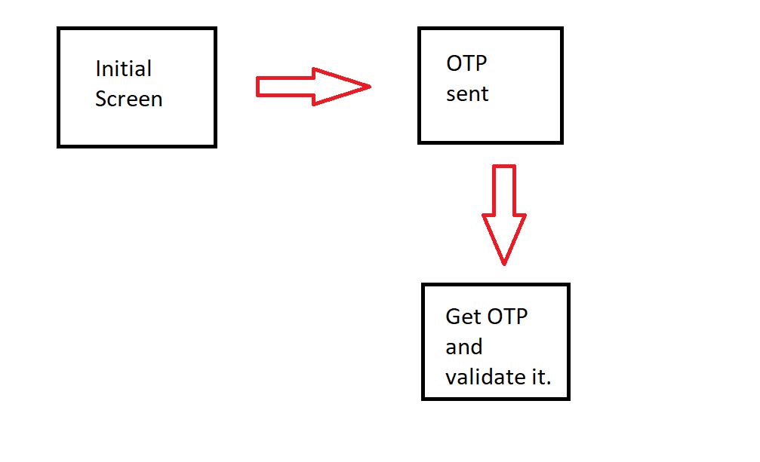
CODE EXPLANATION AND DESIGN STEPS
Step 7: Use this function generate_otp which takes a parameter called length which specifies the desired length of OTP.
Step 8: send_otp() function used to send OTP to specified recipient.
Step 9: verify_otp() function will verify whether the user input and generated OTP are matched or not.
Step 10: resend_otp() function will send the OTP again if OTP does not match.
Step 11: Create window tk() which contains all GUI elements.
Step 12: Widgets are added in between to design interface(like buttons,labels,entry fields).
Step 13: mainloop() to run the application of the window created.

Slide 10
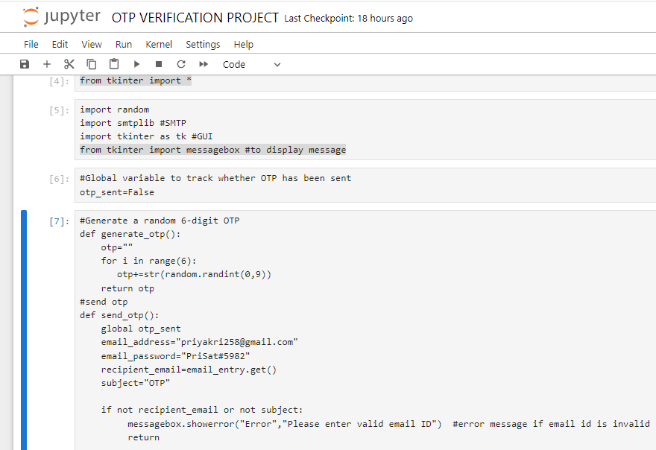
CODE

Slide 11
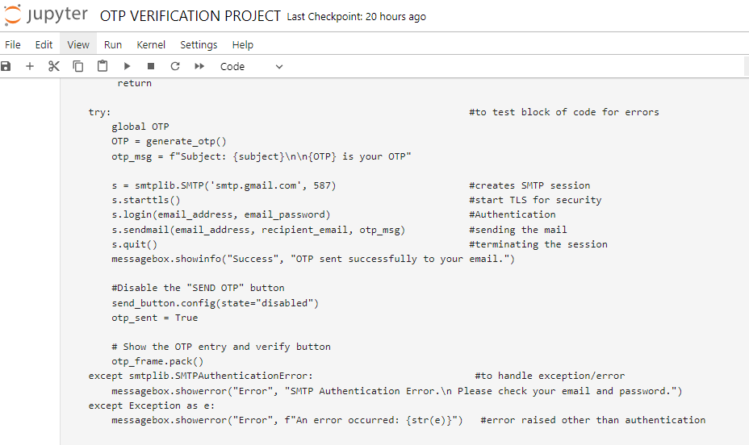
CODE

Slide 12
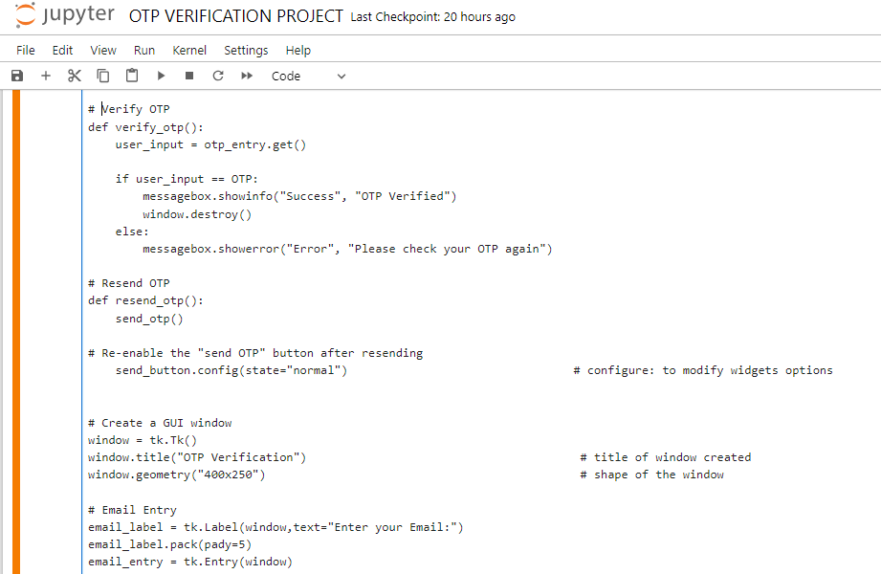
CODE

Slide 13
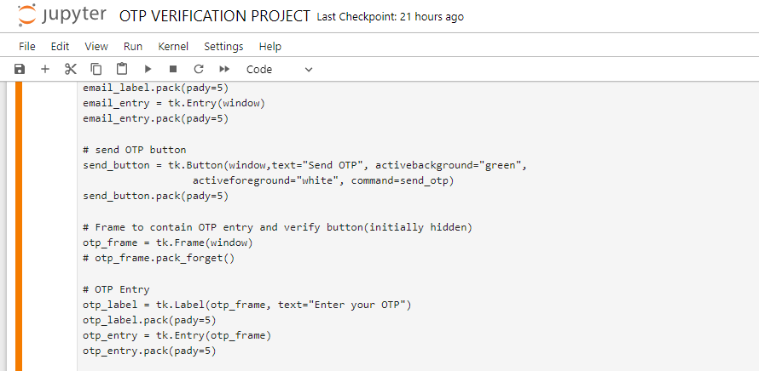
CODE

Slide 14
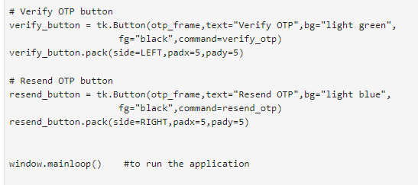
CODE

Slide 15
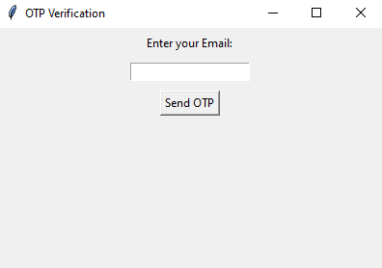

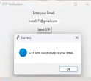

OUTPUT OF VERIFICATION USING OTP
On running the OTP On entering the
VERIFICATION program, correct OTP it
displays a window to shows OTP
Enter your Email. Verified.
Hit send OTP button If you enter the
and check for OTP sent wrong OTP, the
to mail. program displays a
message box
saying Please
check your OTP
again.

Slide 16
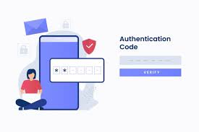
CONCLUSION
This project provides a simple implementation of OTP verification using Python and email.
We can integrate this code into our applications to add an extra layer of security to user authentication.
Developed an OTP VERIFICATION SYSTEM using python and tkinter GUI for secure authentication.
One-time passwords (OTPs) are a highly effective method of providing an extra layer of security to online authentication processes.
By requiring an OTP in addition to a traditional password, businesses can significantly reduce the risk of unauthorized access, data breaches, and account hijacking.

Slide 17


